Slide 1


P1
Group 6
AI MARKET
Analyzing Public Perception of Deepseek’s Influence on the AI Market
By: Alex Ivanoff, Brynn Butler, Noah Schmidt, Pojanart Foote, and Stephanie Fritz

Slide 2

Introduction &
Objectives

Slide 3


The Big Picture
The AI market is expanding rapidly, with new players emerging
Deepseek is one of the newest AI companies gaining media attention
Public sentiment influences stock performance and investment decisions
Notes:
The artificial intelligence industry is rapidly growing, with companies like Google, Microsoft, and NVIDIA investing billions into AI development. Recently, Deepseek has entered the market, sparking discussions about its potential to disrupt the AI landscape. Our project focuses on how the public and investors perceive Deepseek’s influence and whether its advancements impact stock market trends.

Slide 4

Research Goals
Understand public perception of Deepseek’s role in AI
Analyze AI stock trends over the past two years
Determine whether Deepseek’s emergence impacts investor confidence

Slide 5

Research Questions
How have AI stock prices (Google, Microsoft, etc.) performed compared to the Nasdaq Composite Index over the past two years?
What is the overall sentiment (positive, negative, neutral) surrounding Deepseek in news articles, and what themes drive this sentiment?
How has Deepseek’s entrance and technological advancements influenced investor sentiments and AI stock performance?
Notes:
To explore this topic, we structured our analysis around three key research questions:

Slide 6
AI Market: Trends, Variables, and Impact.
Growth
Elaborate on what you want to discuss.
Key Factors
Elaborate on what you want to discuss.
Stock Trends
Elaborate on what you want to discuss.

Slide 7

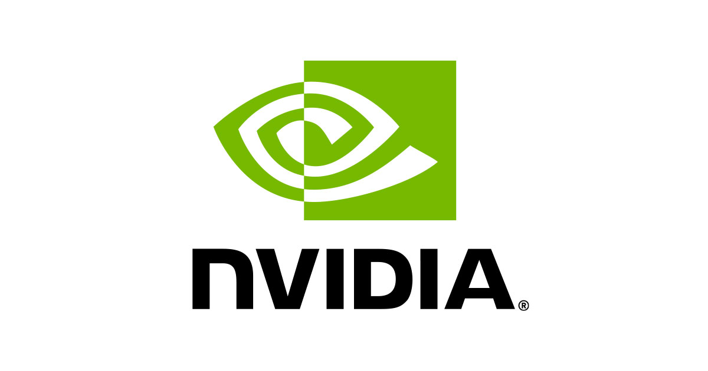


Key Players in the Industry
The AI Powerhouses
Google
NVIDIA
Microsoft
Deepseek
Has been a leader in AI through DeepMind and GoogleAI, powering advancements in search algorithms, natural language processing, and AI-powered tool like Gemini
Is a key player through its partnership with OpenAI, integrating AI into its Azure cloud platform and consumer applications like Copilot and Office 365.
Though newer, is gaining traction with its AI models, and its entrance has raised questions about how it will compete with these establishes giants.
Plays a crucial by providing the hardware backbone for AI with its powerful GPUs, which are essential for AI model training and deep learning.
Notes:
Start: Before diving into Deepseek’s impact, it’s important to understand the major players in AI. The industry is dominated by companies that invest heavily in artificial intelligence, shaping the future of automation, machine learning, and AI applications.
(read slides)
End: With these key players in mind, we’ll now look at how we collected data on AI stocks and news sentiment to analyze Deepseek’s impact.

Slide 8
Deepseek’s Announcement & AI Stock Reactions
Before (1/10/25)
Immediate Aftermath (1/28/25)
Google (Alphabet Inc.): $192.50
Microsoft: $415.00
NVIDIA: $135.00
Google (Alphabet Inc.): $185.34
(drop of ~1.4%)
Microsoft: $409.75
(drop of ~0.2%)
NVIDIA: $126.75
(drop of ~1.7%)
Announcement (1/27/25)
Currently (2/8/25)
Google (Alphabet Inc.): $188.00
(drop of ~2.3%)
Microsoft: $410.50
(drop of ~1.1%)
NVIDIA: $129.00
(drop of ~4.4%)
Google (Alphabet Inc.): $185.34
(stabilized)
Microsoft: $409.75
(stabilized)
NVIDIA: $129.84
(stabilized)

Slide 9
Data Collection & Sources
Where the data came from:
News articles & sentiment analysis
Google News API
Yahoo Finance API
Stock market data
Yahoo Finance API
NASDAQ Composite Index
Data cleaning steps:
(if applicable)
Notes:
Our goal is to analyze how Deepseek’s entrance into the AI industry has shaped public perception and investor sentiment. To do this, we will examine stock price trends, sentiment in news articles, and correlation between Deepseek’s developments and AI stock movements.

Slide 10

Analysis Approach
Briefly explain the analysis approach (example):
Sentiment Analysis (positive, neutral, negative classification)
Topic Modeling (finding key themes in news coverage)
Stock Market Trends (comparing AI companies to Nasdaq performance)
Statistical Analysis (correlation, regression, time series)

Slide 11
Data Visualizations
&
Key Insights

Slide 12
Stock Market Performance
Line chart comparing AI tech stocks to Nasdaq over the past two years

Slide 13
Sentiment Analysis
Pie chart or bar graph showing Deepseek-related sentiment distribution

Slide 14
Sentiment Over Time
Line graph tracking how public sentiment has changed over key events

Slide 15
Topic Analysis
Word cloud or bar chart of most common themes in news coverage

Slide 16
Deepseek’s Impact on AI Stocks
Scatter plot or regression analysis showing the correlation between sentiment and stock movement

Slide 17
Key Findings
&
Conclusion

Slide 18

Major Takeaways
Summarize major takeaways:
Did sentiment positively or negatively affect AI stock performance?
What themes dominate Deepseek discussions?
Are AI stocks more volatile or stable compared to Nasdaq?
How has Deepseek’s presence shaped market perception?

Slide 19

Challenges & Limitations
Example
Example
Presentations are
communication tools
Presentations are
communication tools
Example
Example
Presentations are
communication tools
Presentations are
communication tools

Slide 20

Thank you!
Any Questions?

Slide 21





Resource
Page
Use these design resources in your Canva Presentation.
You can find these fonts online too. Happy designing!
Don't forget to delete this page before presenting.
This presentation template uses the following free fonts:
Titles: Russo One
Headers: Montserrat
Body Copy: Open Sauce

